Slide 1
Safeguarding Foundations
Aims and Outcomes
Edition 02. AUGUST 2021
Aims:
To enable learners to contribute to, and implement, good safeguarding practice within church and community contexts.
By the end of this course, you will be able to:
Explore safeguarding within Christian communities with particular attention to the voice of victims and survivors.
Recognise issues of power and vulnerability arising from the age or circumstances of those affected, and how these issues inform appropriate action.
Apply some principles for safer ministry to a variety of case study scenarios.
Identify wider support, accountability and governance arrangements relevant for safeguarding in their context.
Introduction

Slide 2
Safeguarding Foundations
Course Overview
1
3
4
5
2
Learning from
experience
Focusing on
Children and
Young people
Focusing on
vulnerable
adults
Final
Assessment
Understanding
power and
vulnerability
Introduction

Slide 3
Safeguarding Foundations
Advance Warning and Guidance
Warning : This course may
provoke strong feelings,
reactions or concerns...
Make use of
help and
support
Report any
concerns
you may have
Take a break if you need to
Introduction

Slide 4
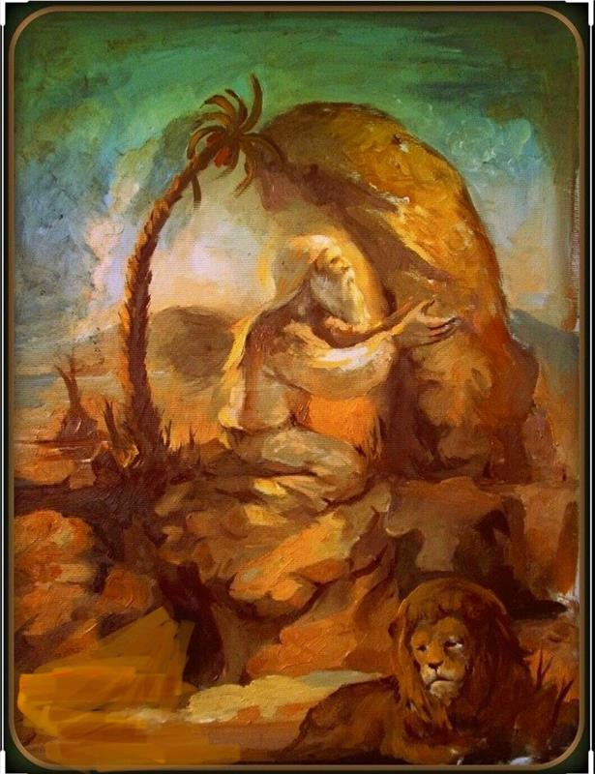
Safeguarding Foundations
Opening Activity - Perspectives
It's natural that we bring our own interpretation to the picture...
Sometimes what we see is shaped by what we expect to see...
Sometimes, what we see is what we prefer to see....
These factors often play a role in safeguarding situations
Part 1 - Learning from experience

Slide 5
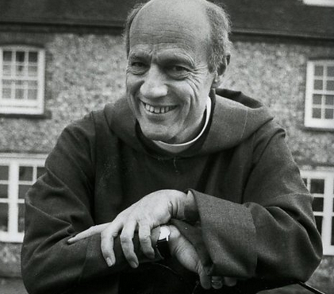
Safeguarding Foundations
The case of Peter Bell and Neil Todd
Peter Ball was British bishop in the Church of England and
a convicted sex offender.
1980 - Started a 'Give a Year to God' scheme in his
own home and involved members in religious
rituals that involved acts of nudity.
Sentenced in 2015, Ball admits the abuse of 18 young
men over a period of 15 years from 1977 to 1992
Peter Ball, Suffragan Bishop of Lewes 1977 - 1992
Diocesan Bishop of Gloucester 1992 - 1993
Part 1 - Learning from experience

Slide 6
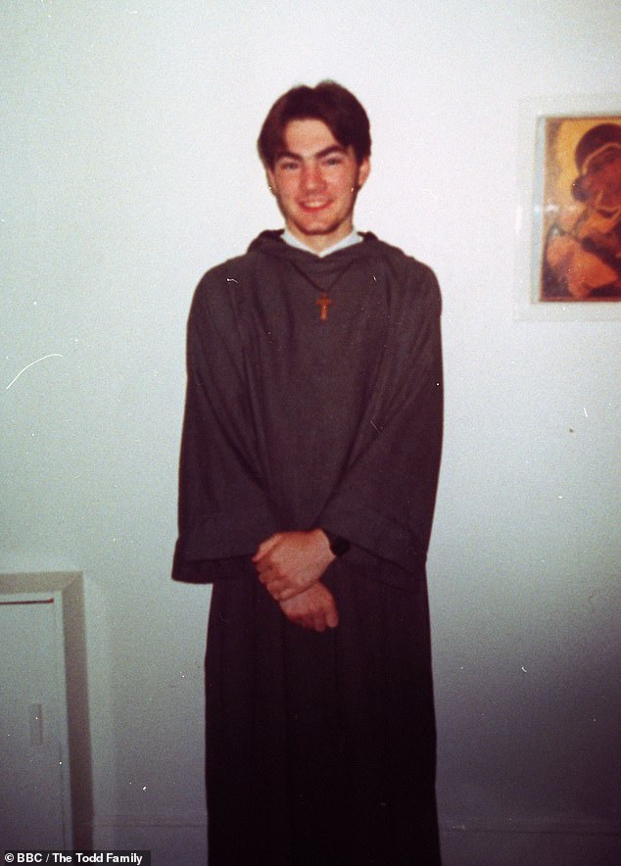
Safeguarding Foundations
Neil Todd
Wrote to Peter Ball in 1991 expressing his desire
to join a religious community.
Peter Ball subjected him to abuse from
the first night in his house.
Neil reported his abuse to senior figures in
the Church of England,
but Peter Ball was not barred from ministry
and was merely cautioned by police in 1993.
After a formal investigation is set up by Sussex police
in July 2012, Neil dies in hospital following
a third suicide attempt in August of the same year.
Neil Todd
Part 1 - Learning from experience

Slide 7
Safeguarding Foundations
Quotations from the Peter Ball case review
“Peter Ball abused his faith and his Church, appearing outwardly as a good and holy man while actively harming others. He abused the faith that people rightly had in him as a leader in the Church, and most importantly he abused the faith of those who sought spiritual guidance from him, and instead found hurt, deceit, and manipulation.”
Dame Moira Gibb (2017)
“If a charlatan with an insatiable appetite for abuse wanted to secure a continuous supply of vulnerable young victims, there was no better way of achieving this than by founding a religious order not subject to any external supervision, and by making his victims' participation in the abuse a religious duty obligated by their oath of absolute obedience…. Most of all, however, Peter Ball found in his fellow bishops in the Church of England the perfect accomplices, prepared to turn a blind eye to his abuse over many decades, to collude in the lie that the abuse of Neil Todd was an uncharacteristic aberration, to cast doubt on his guilt, to smear his victims, and to rehabilitate him.”
Richard Scorer, Lawyer to abuse survivors (2020)
Part 1 - Learning from experience

Slide 8
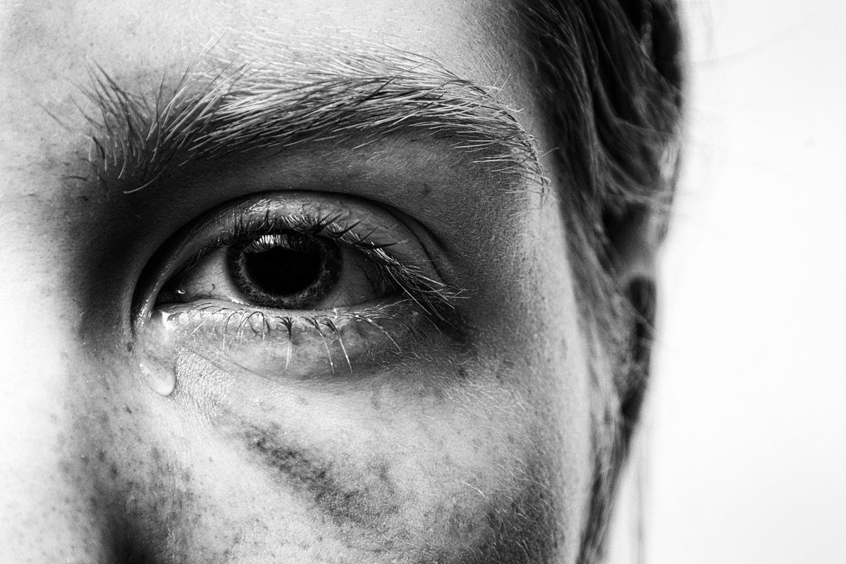
Safeguarding Foundations
Reflections
A lack of transparency and accountability
b) Unquestioned exercise of power and authority
c) Use of scripture and theology to justify abuse
d) The trivialisation of allegations, resulting in the silencing of victims
e) Tribalism
Part 1 - Learning from experience

Slide 9
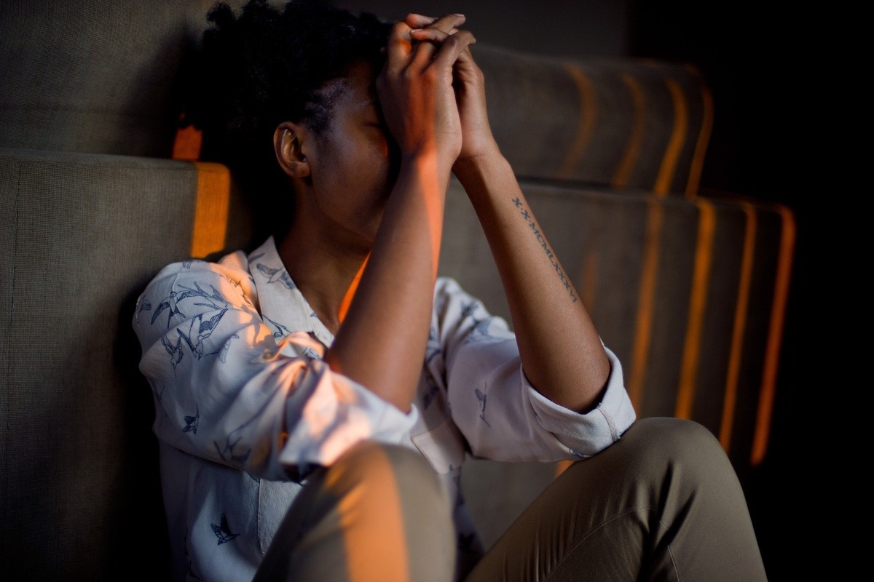
Safeguarding Foundations
Jeremiah Reflection
“For I know the plans I have for you, says the Lord. Plans to prosper you and not to harm you.”
Jeremiah 29:11
Part 1 - Learning from experience

Slide 10
Safeguarding Foundations
Principles for safer working
Being attentive, aware and listening to the voice of the vulnerable.
Transparency and accountability in all areas and levels of church life.
Taking responsibility for the role we each play in our community.
Acting in practical ways that reduce risk of harm and promote wellbeing.
Part 1 - Learning from experience

Slide 11
Safeguarding Foundations
Review your learning (1 of 3)
The opening activity highlighted the role that expectations play in interpreting safeguarding situations.
How did this impact the Peter Ball and Neil Todd case?
Choose TWO from the following:
People expect church leaders to be absolutely good and trustworthy, so struggled to believe that Peter Ball could act in this way.
The allegations that were made conflicted too much with the picture of himself that Peter Ball presented in public.
I don't think that peoples expectations affected their perception of the real situation in this case.
Part 1 - Learning from experience

Slide 12
Safeguarding Foundations
Review your learning (2 of 3)
In this course so far we have noted 5 cultural factors in the church that enabled abuse to occur - and to continue.
4 of these were:
1) Unquestioned power and authority
2) Justifying abuse on the basis of scripture and theology
3) Trivialisation of allegations
4) Tribalism
What was the 5th ?
Lack of accountability and transparency
The teaching of St Francis of Assisi
Setting up religious communities
Part 1 - Learning from experience

Slide 13
Safeguarding Foundations
Review your learning (3 of 3)
The treatment of Neil Todd was appalling and highlights the need to change our attitude and practice in the church.
What are the risks of not acknowledging mistakes and not changing our practice?
Choose as many as you think are correct from the following.
Further damage to the public perception and trust of the church and Christians.
Failing to be honest about and take sin seriously in the church.
Significant damage to individuals' development, mental health and value as human beings.
I don't think that there is anything essentially wrong with church culture and practice. This is an exceptional case.
Part 1 - Learning from experience

Slide 14
Safeguarding Foundations
Understanding power and vulnerability
Power can be understood as...
...ability to potentially impose your own will on a given situation, for good or for ill.
Power can be rooted in…
…an individual’s attributes eg. physical strength, knowledge, or social factors eg. age, gender, wealth, position.
Therefore in any situation..
an individual or group may be more powerful, or more vulnerable than another.
Those who are less powerful...
are less able to determine their own lives, to protect themselves and to thrive without being significantly dependent on others.
Part 2 - Power and vulnerability

Slide 15
Safeguarding Foundations
The vulnerable in our communities
In society...
...there is a moral duty to protect and support the vulnerable and prevent them from harm.
The church...
...is a community where the relatively powerful are brought together with the relatively weak.
The work of the Holy Spirit....
...increases our love for our neighbour and our compassionate awareness of those weaker than ourselves.
Healthy churches...
are inclusive places where individuals are deeply committed to the care and protection of one another.
Part 2 - Power and vulnerability

Slide 16
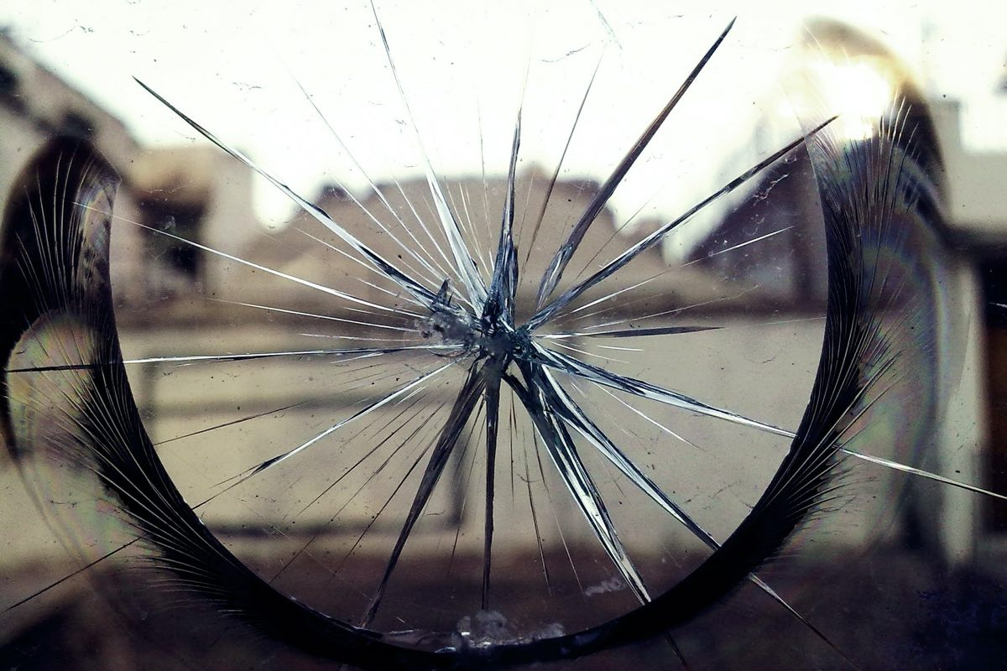
Safeguarding Foundations
The vulnerable in our communities
Family stress factors can make the most vulnerable at greater risk of abuse
Alcohol or drug misuse
Disorganised or anti-social families
Social isolation
Domestic violence and abuse
Disability
Mental health issues or learning disabilities
Family history
Cultural or religious factors
Financial problems
Overcrowded or precariously housed families
Addictive behaviour
Relationship breakdown
Being a refugee or asylum seeker
Part 2 - Power and vulnerability

Slide 17
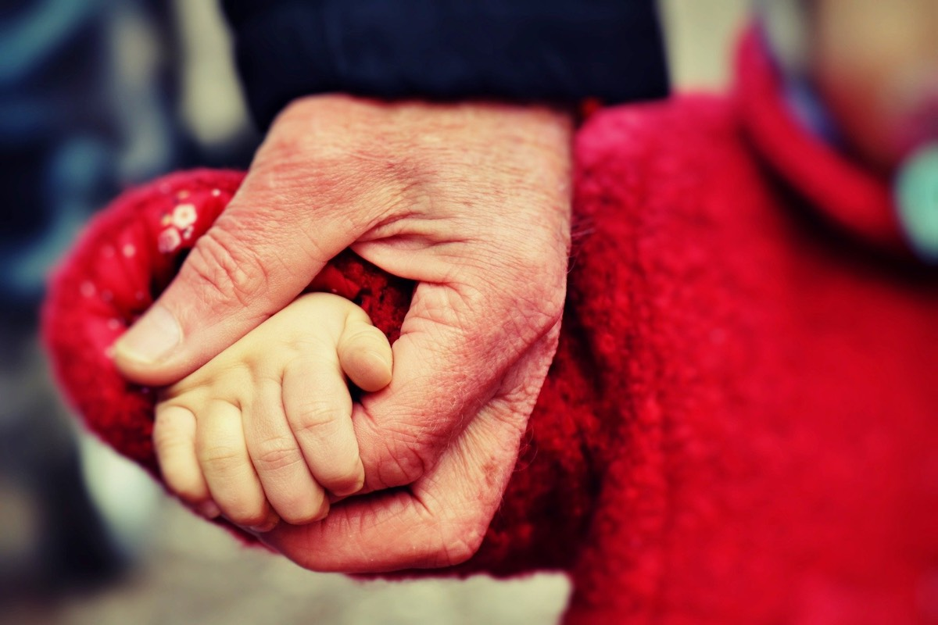
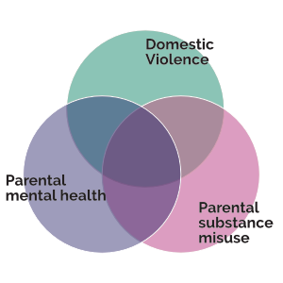
Safeguarding Foundations
Focus on children and the toxic trio
Children are vulnerable because:
They are unable to completely provide for their own welfare, security, food and clothing.
Instinctively, they will look toward and trust adults to protect, support and nurture them.
Therefore, children within families experiencing high levels of stress (as indicated on the previous slide) are likely to be at higher risk of abuse or neglect.
The 'Toxic Trio'
Working Together to Safeguard Children (2018)
Part 3 - Children and young people

Slide 18
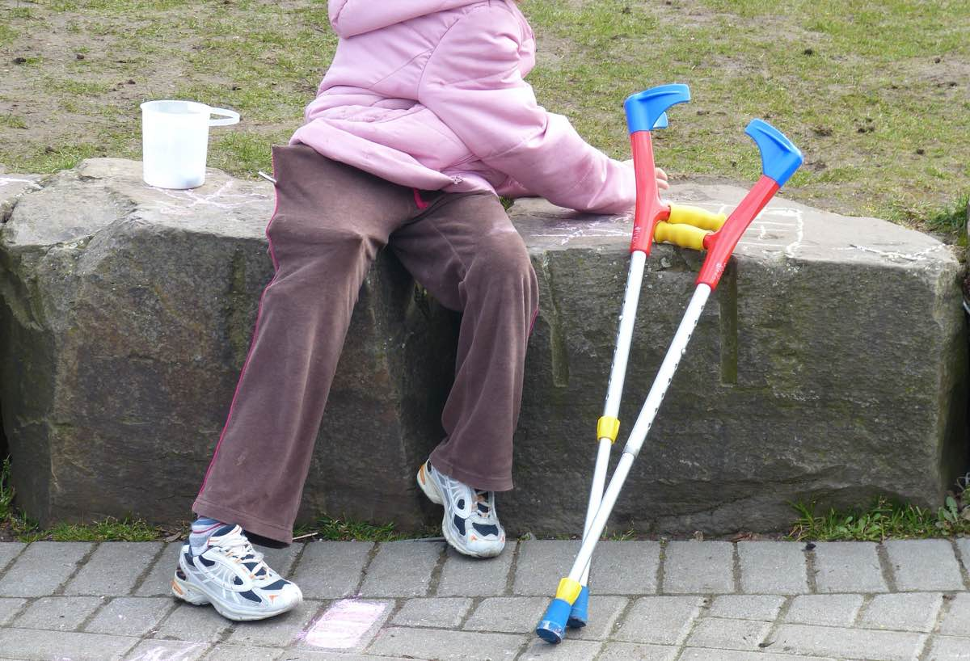
Safeguarding Foundations
Children with additional needs
Dependence on a wide network of carers
More difficult to maintain boundaries in caring relationships
Communication barriers
Many of the usual channels to report abuse are inaccessible
Part 3 - Children and young people

Slide 19
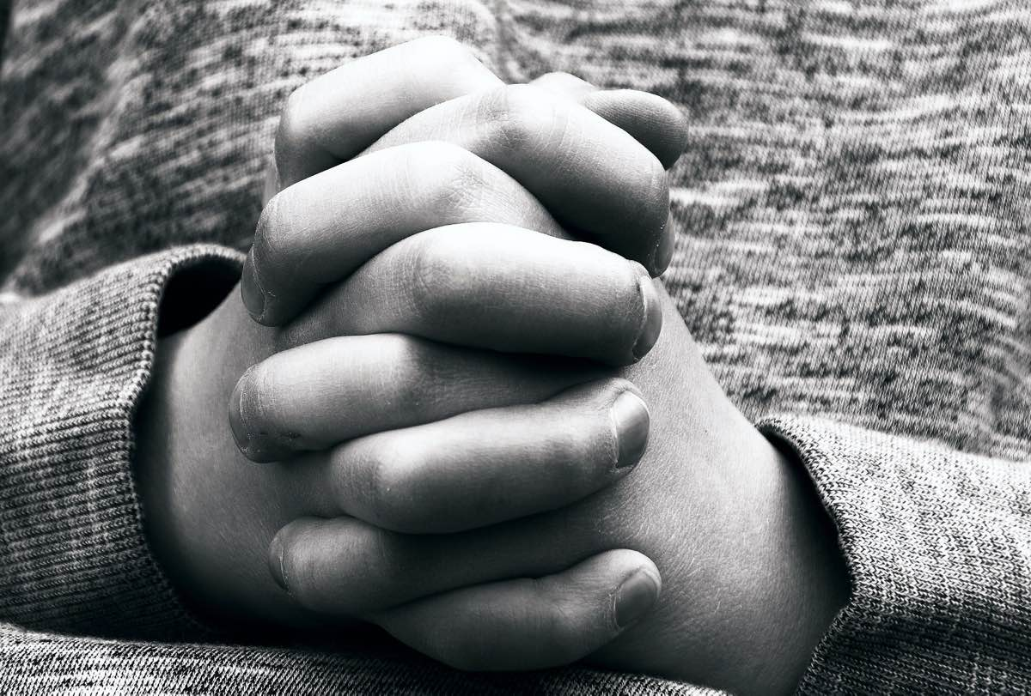
Safeguarding Foundations
Children in the church
Provide an open, transparent, positive, safe, nurturing environment
Be aware that their home environment may not be safe or nurturing
This can be complex, but it is essential
Ensure that all ministry is undertaken by those who intend ‘good and not harm’
Part 3 - Children and young people

Slide 20
21
Safeguarding Foundations
Scenario - Peters story Q1 & 2
You and an assistant lead a group for children ages 6-8 years old on a Sunday morning during the church service. A boy called Peter comes every week; his parents also regularly attend your church. You are aware that Peter’s mother has recently lost her job.
One Sunday you ask the children to make drawings showing their family and things that are important in life. Peter drew himself with a sad face and what looked like his Mum and Dad hitting each other. He then started crying and pushed his crayons off the table. The other children begin looking at Peter.
What are your first thoughts?
A. Children behave like this all the time; it does not mean that there is something seriously wrong at home.
B. Whatever is going on at home, I need to recognise that Peter is not coping with it and needs support.
C. I think it is positive that Peter has been able to express himself in this way.
What are your concerns?
A. Peter may be subject to, or witnessing, domestic violence.
B. One or both of Peter’s parents may be physically and emotionally abusing the other
C. Financial issues may be an underlying stress factor for this family
Part 3 - Children and young people

Slide 21
Safeguarding Foundations
Scenario 1 - Peter’s story (continued)
You and an assistant lead a group for children ages 6-8 years old on a Sunday morning during the church service. A boy called Peter comes every week; his parents also regularly attend your church. You are aware that Peter’s mother has recently lost her job.
One Sunday you ask the children to make drawings showing their family and things that are important in life. Peter drew himself with a sad face and what looked like his Mum and Dad hitting each other. He then started crying and pushed his crayons off the table. The other children begin looking at Peter.
How do you respond as leader of the group?
A. Explain to the rest of the children in the group that Peter is upset because his parents are fighting.
B. Ask your assistant leader to sit with Peter and offer some comfort until the end of the group.
C. Take Peter out of the group and take him back to his parents so that they can console him.
After the group session is finished, you are discussing the incident with your assistant. They say : “No-one must know about this, Peter’s parents would be embarrassed. They have been coming to church for years and I’m sure there is nothing to worry about. They would be really angry if they knew we had not spoken to them first”
How do you respond?
A. We have a primary responsibility to the most vulnerable person in the situation, which in this case is Peter, and need to act in his interests.
B. We should not be party to concealing potential abuse, even if it involves long-standing members of the church; we should report this to the appropriate person and maintain confidentiality.
C. We should give Peter’s drawing to his parents and ask to meet with them later in the week to discuss it.
Part 3 - Children and young people

Slide 22
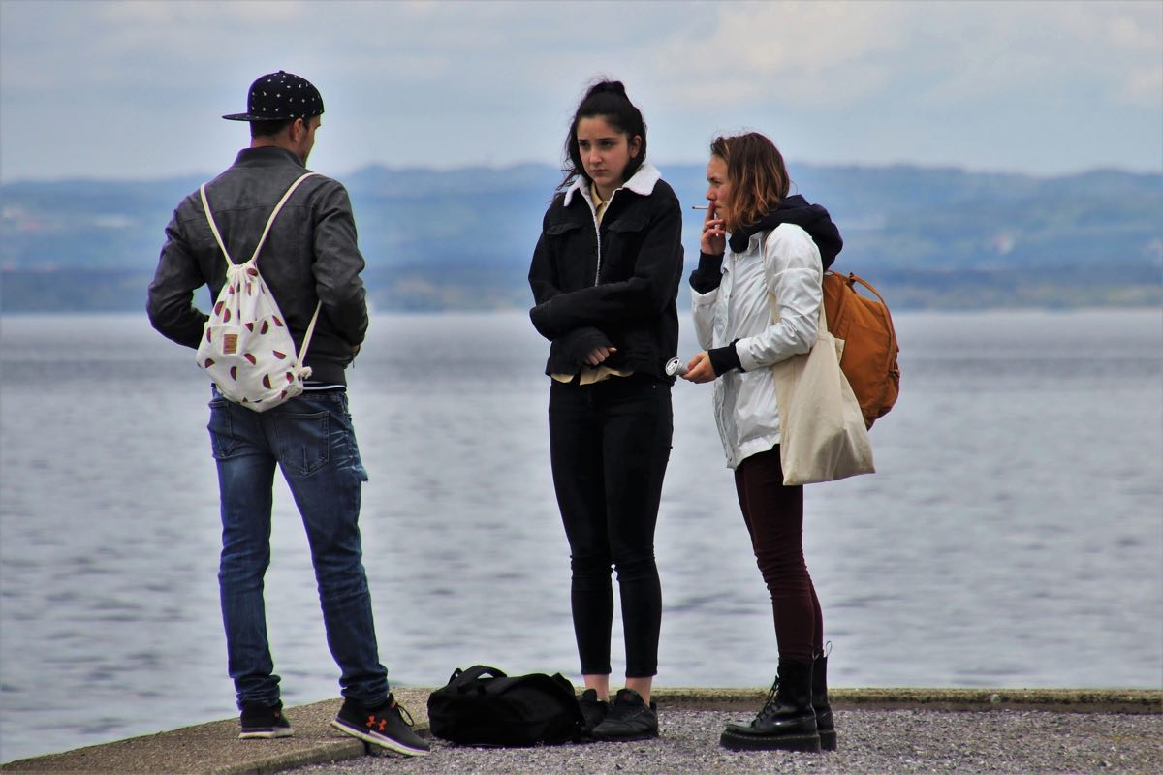
Safeguarding Foundations
Young people
From a legal point of view, young people are considered 'children'
Able to choose where they spend their time and with whom
Time of significant change - relationship with parents, sexual activity, experimentation with drugs or alcohol
Young people are still relatively inexperienced
Online environments become increasingly relevant
Different issues may arise in pastoral work
Increase in the use of the internet to target, groom and abuse young people
Adults sometimes pose as children in order to obtain images or engineer meetings
Part 3 - Children and young people

Slide 23
Safeguarding Foundations
Scenario - Abbi’s Story part 1
A young person (a 14 year old female) called Abbi tells you that they have been speaking privately to an adult friend of her parents, a member of your congregation, on WhatsApp.
These conversations often happen late at night, but she says, “it’s okay because they are best friends and their families are very close.” You ask what sorts of things they chat about. Abbi says “sometimes we send pictures to each other, which is quite fun. They bought me an app that helps me cut and paste pictures and edit them and all sorts, it’s really amazing.”
What are your immediate thoughts?
A. Abbi may be feeling valued and appreciated by the attention and gifts, and not recognise the potential risk in this situation. She could be being groomed.
B. I’m concerned about the lack of openness and accountability in the relationship developing between Abbi and this adult; its exclusivity does not seem quite right.
C. I’m not too concerned about this, because Abbi has not disclosed any inappropriate conversations.
How do you respond to Abbi?
A. Explain to her that she is being groomed and that she should report this to the police.
B. Ask her whether or not she has chatted to her parents about her new app.
Part 3 - Children and young people

Slide 24
Safeguarding Foundations
Scenario - Abbi’s Story part 2
A young person (a 14 year old female) called Abbi tells you that they have been speaking privately to an adult friend of her parents, a member of your congregation, on WhatsApp.
These conversations often happen late at night, but she says, “it’s okay because they are best friends and their families are very close.” You ask what sorts of things they chat about. Abbi says “sometimes we send pictures to each other, which is quite fun. They bought me an app that helps me cut and paste pictures and edit them and all sorts, it’s really amazing.”
What else should you do?
A. Not mentioning this issue in particular, suggest that the church does some awareness-raising with young people about social media.
B. Make a record and speak with the safeguarding officer about this conversation.
C. Warn parents of other young people in the church about this person that Abbi is in communication with.
Part 3 - Children and young people

Slide 25
Safeguarding Foundations
Review your learning (CYP) - 1 of 3
We have spent some time considering power and vulnerability and relating these issues to children and young people.
Think back on what you have learned and choose TWO factors from the list below that are common to both children and young people and make them vulnerable.
Limited life experience and education.
Using the internet
They are dependent on others for essential needs.
Alcohol misuse
Review your learning - 1 of 3

Slide 26
Safeguarding Foundations
Review your learning (CYP) - 2 of 3
True or false?
Children or young people with additional needs are more likely to experience abuse or neglect.
Review your learning - 2 of 3

Slide 27
Safeguarding Foundations
Review your learning (CYP) - 3 of 3
Earlier in this part of the course, we identified a range of family stress factors including the 'toxic trio'.
Why is it important to recognise these when it comes to safeguarding?
Choose TWO from the following:
If we are aware of these factors, we should avoid too much contact because we might put ourselves in danger.
This can shed light on the behaviours that children and young people may exhibit in ministry situations.
These increase the likelihood of children and young people experiencing abuse or neglect in the family home.
Review your learning - 3 of 3

Slide 28
Safeguarding Foundations
Pause and Reflect
Take the opportunity to have a break and digest the content of this course so far
What has been the most challenging aspect of the course so far?
How have the issues raised challenged your faith?
Have they highlighted anything in particular in your own community?
Is there any action you need to take?
Pause and Reflect - 50% complete

Slide 29
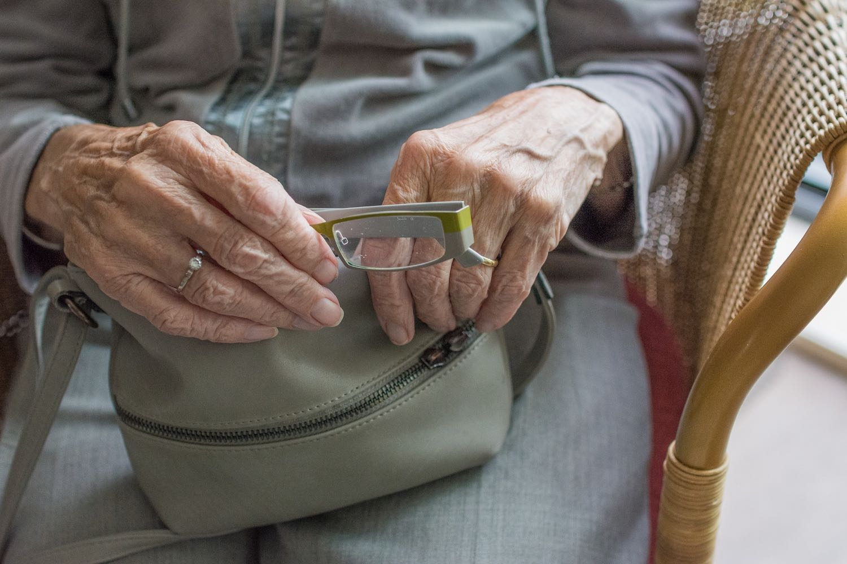
Safeguarding Foundations
Safeguarding adults - the Care Act 2014
Empowerment
Prevention
Proportionality
“We will encourage people to make their own decisions.”
“We think its better to take action before harm occurs.”
“We will seek the least intrusive response to the risk presented.”
Protection
Partnership
Accountability
“We will support and represent those in greatest need.”
“We will work with others in our local community to detect and report concerns.”
"We will seek to be accountable and transparent in all matters relating to safeguarding."
Part 4 - Safeguarding adults

Slide 30
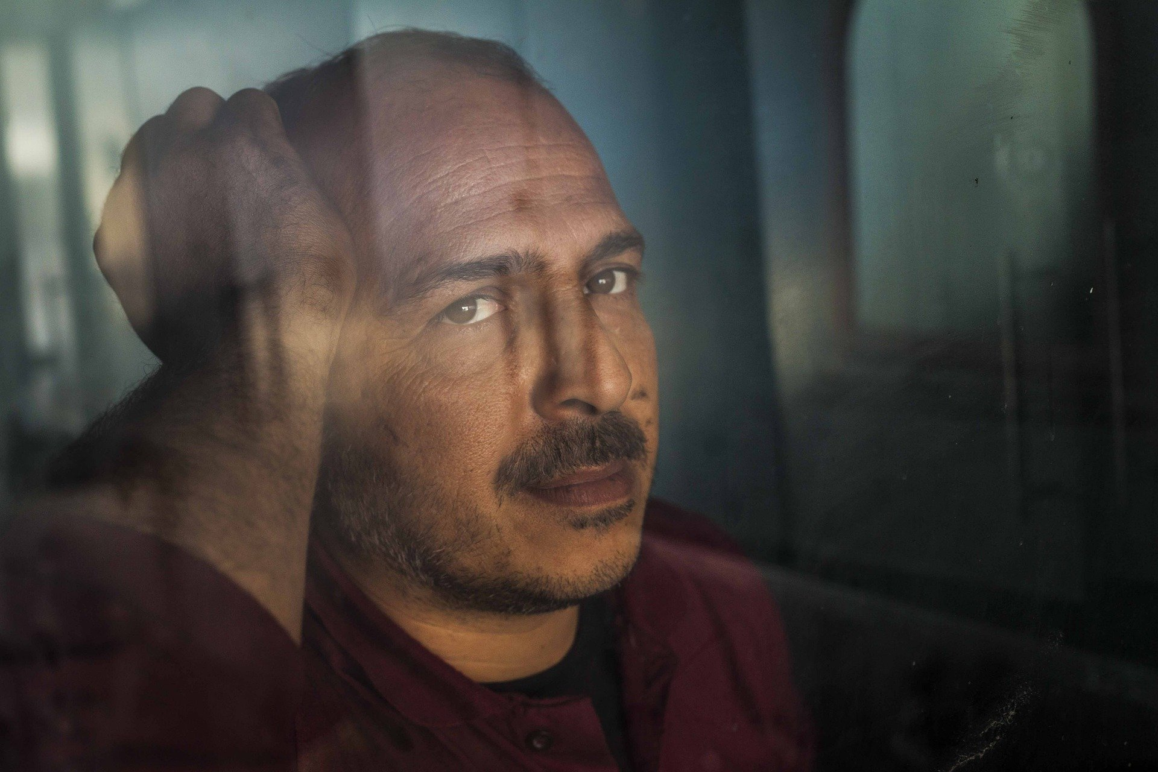
Safeguarding Foundations
The Mental Capacity Act 2005
The Mental Capacity Act 2005 is a statutory framework that allows for decision making on behalf of people over the age of 16 who have a mental incapacity.
Personal welfare decisions
Mental healthcare decisions
Financial decisions
It must be assumed that a person has capacity unless proved otherwise.
All practicable steps must be taken to help a person make a decision before they are deemed unable.
People are able to make unwise decisions without being deemed incapable of making a decision.
Any decision or action taken on behalf of another must be done in their best interest.
Before decisions are made or actions taken on behalf of another, consideration must be given to alternative and less restrictive ways of proceeding.
Part 4 - Safeguarding adults

Slide 31
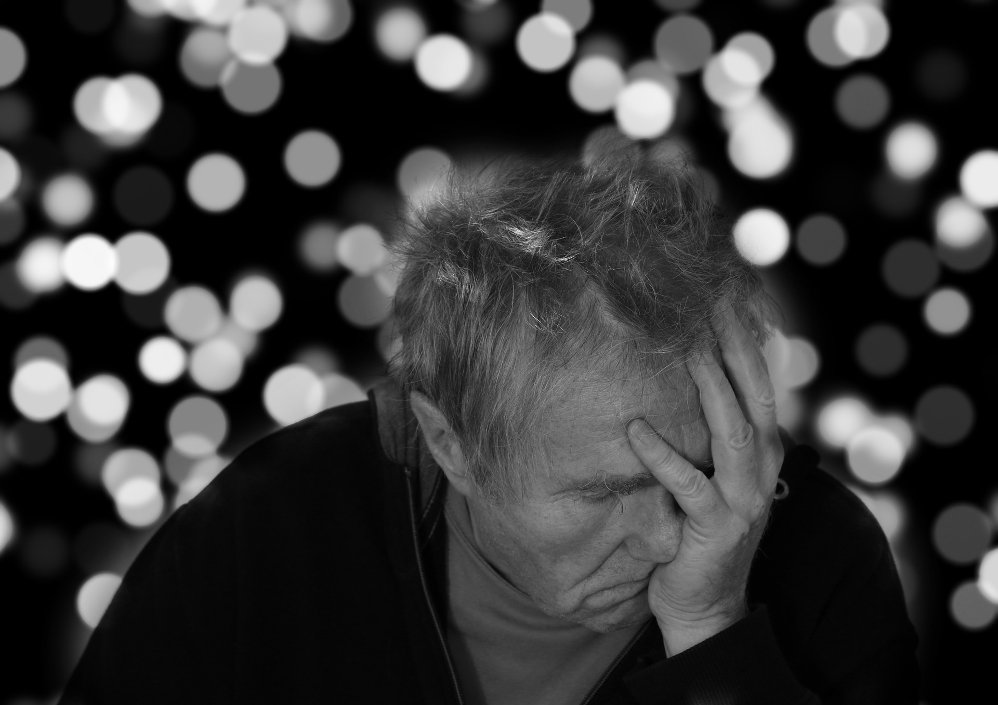
Safeguarding Foundations
What is an ‘adult with safeguarding needs’?
“ ’Adult with safeguarding needs’ is a term that covers a wide range of people, from those with a learning disability to those experiencing dementia - and may also include adults whose mental capacity fluctuates, such as those with mental health or substance misuse difficulties. Some adults with safeguarding needs may be living in special accommodation and others will be living in the community on their own or with family members.”
Social Care Institute of Excellence SCIE, 2017
1. The extent to which they are able to make - and carry out - their own informed choices.
2. How able they are to protect themselves from abuse, neglect and exploitation.
Part 4 - Safeguarding adults

Slide 32
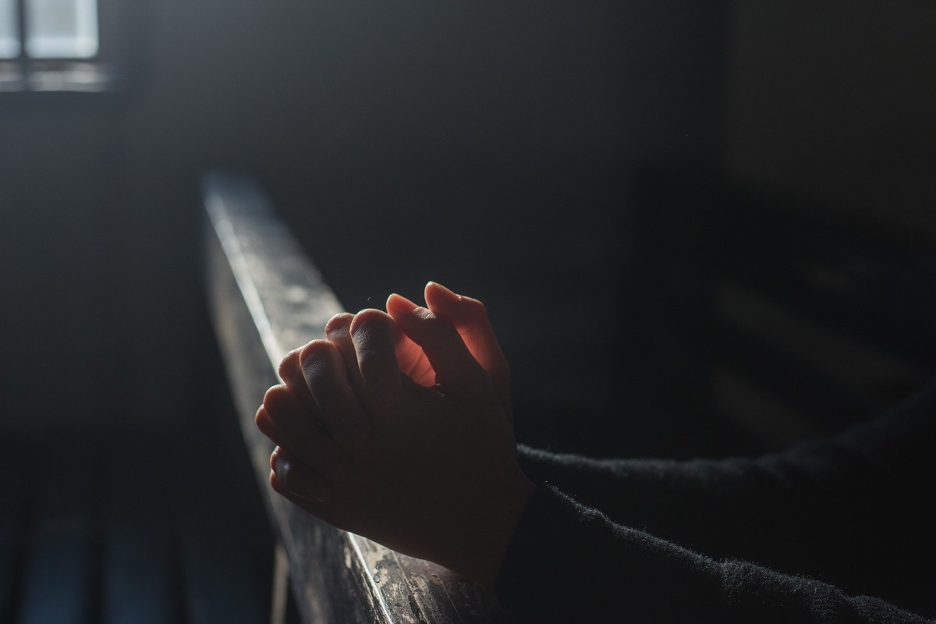
Safeguarding Foundations
Vulnerable adults and the church
The church often provides practical support and pastoral care for vulnerable adults
They will be significantly dependent on a range of others from their family, the community, healthcare providers and the church
Enabling their access, participation and contribution to our life together as a Christian community.
Part 4 - Safeguarding adults

Slide 33
Safeguarding Foundations
Scenario - Andrea’s story
Andrea married her partner David 3 years ago. She has a learning disability. Shortly after their marriage Andrea was diagnosed with rheumatoid arthritis. The disease progressed rapidly, and Andrea now suffers from significant pain in her joints and has mobility problems.
Andrea used to work as a cleaner, but she became unable to cope with the demands of the work and left the job a year ago.
Listen to or read the conversation between Andrea and a pastoral visitor by playing the video. Then take a few minutes to think through the scenario, before proceeding to the questions that follow.
Part 4 - Safeguarding vulnerable adults

Slide 34
Safeguarding Foundations
Scenario - Andrea’s story Q1 - 3
What are your initial thoughts?
A. Andrea has a learning disability - she is misreading her husband’s treatment of her.
B. Andrea is anxious, unhappy and fearful about her current circumstances.
C. Andrea may feel bad about letting the pastoral visitor down by not answering her calls.
How should the pastoral visitor respond?
A. Wait till Dave arrives and challenge him about Andrea’s car keys and bus pass?
B. Arrange to come back on another occasion when Dave is not there?
C. End the visit by saying, “don’t worry about the food hygiene course, it’s not important, what matters is whether or not you are OK.”
What else should the pastoral visitor do?
A. Make a note about this conversation and speak with a safeguarding officer at the earliest opportunity.
B. Speak with Andrea’s neighbours or family and ask their opinion about Dave and Andrea, to get a fuller picture.
C. Call the police and report the situation.
Part 4 - Safeguarding vulnerable adults

Slide 35
Safeguarding Foundations
Review your learning (Adults) - 1 of 3
At the beginning of this part of the course, we explained the term 'adult with safeguarding needs'.
Which 2 of the following statements combine to provide a clear explanation of this term.
How able they are to protect themselves from abuse, neglect and exploitation.
Whether they are making wise decisions about their own life.
The extent to which they are able to make - and carry out - their own informed choices.
Review your learning (Adults) - 1 of 3

Slide 36
Safeguarding Foundations
Review your learning (Adults) - 2 of 3
True or false?
Adults have the right to self determination unless they are deemed to lack capacity. This could even mean allowing them to choose not to protect themselves.
Review your learning (Adults) - 2 of 3

Slide 37
Safeguarding Foundations
Review your learning (Adults) - 3 of 3
In the Care Act (2014), "supporting and encouraging people to make their own decisions
and give informed consent" is the definition of which principle?
Accountability
Empowerment
Proportionality
Review your learning (Adults) - 3 of 3

Slide 38
Safeguarding Foundations
Protecting ourselves as well as others
Visiting individuals or families in their own home by yourself.
Meeting on a one-to-one basis with a young person.
Giving a lift to another person in your own car.
Children arriving early for an event whilst you are setting up by yourself.
A reminder to take care of ourselves

Slide 39
Safeguarding Foundations
Final assessment - introduction
Welcome to the final assessment for Safeguarding Foundations.
During this assessment you will be asked to apply your learning from this course to THREE different ministry practice scenarios.
Part 5 - Final Assessment

Slide 40
Safeguarding Foundations
Final Assessment (1/7) - Scenario One, Q1
A youth minister decides to start an intensive one-to-one discipleship programme with a selection of young people whom have shown an interest in leadership.
How might they apply the principles of accountability and transparency to this way of working?
Choose THREE from the following:
Making sure parents/guardians are aware of these arrangements and are happy for their child to participate.
Finding an open/public setting where a meeting with a young person might take place.
Share the details of all conversations that takes place in each meeting to another leader.
Make sure that the scope of the meetings are understood and agreed with young people beforehand.
Part 5 - Final Assessment

Slide 41
Safeguarding Foundations
Final Assessment (2/7) - Scenario One, Q2
What else could the Youth worker do in preparation for this piece of work?
Choose THREE from the following:
Reflect on their own position of power/influence in the situation and how this might impact a one-to-one situation.
Make sure there is regular reflection on the programme with their supervisor/line manager.
Make sure that they have access to support and advice should any issues come up that they feel unequipped to handle.
Set up a private social media group using their own personal account.
Part 5 - Final Assessment

Slide 42
Safeguarding Foundations
Final Assessment (3/7) - Scenario Two, Q1
You are just starting out as a volunteer in the children's ministry in your church, and are invited to observe an after school club as part of your induction.
During the session, one of the leaders becomes very angry with the children because they would not follow her instructions and starts shouting aggressively at them, grabbing one of them by the arm, and calling them ungrateful for the sacrifice they make for them each week by turning up to run the club. After this incident, the club runs smoothly and the children seem to behave well and enjoy themselves, and leave happy.
What do you think about this?
I'm not an expert in children's ministry, therefore I do not know whether this leader was wrong to do what they did.
Regardless of the behavior of the children, the club leader should not be treating them this way. What just happened could be considered physical and verbal abuse.
The actions of the club leader were reasonable given the circumstances. They were right to be angry and let the children know that they felt unappreciated.
Part 5 - Final Assessment

Slide 43
Safeguarding Foundations
Final Assessment (4/7) - Scenario Two, Q2
What should you do following witnessing this incident?
Choose TWO from the following:
Resign as a volunteer so that you are not associated with unsafe ministry practice.
Make a note of what happened and report to the safeguarding officer as soon as you can.
Ask your church leader if they are aware of any training that could be completed on managing children’s behaviour.
Part 5 - Final Assessment

Slide 44
Safeguarding Foundations
Final Assessment (5/7) - Scenario Three, Q1
You have befriended a member of your congregation who is elderly, physically disabled and lives by themselves. During one visit they complain that they are often hungry and can't afford to buy food. As the conversation develops, you discover that two of her neighbours sometimes come round and tidy up for her and then ask for money in exchange. They don't feel that they can say no to them.
What is your concern?
Choose TWO from the following:
I don't have any concerns; they are lucky to have such caring neighbours.
They are very vulnerable person. It's not clear that they want the help of their neighbours, they may be being exploited.
They are not eating enough and this is affecting their health and well-being.
Part 5 - Final Assessment

Slide 45
Safeguarding Foundations
Final Assessment (6/7) - Scenario Three, Q2
What are your next steps?
Choose TWO from the following:
Tell them about other local organisations that might be able to support them eg. Food Banks, Christians Against Poverty and offer to help to access if they would like.
Ask them whether or not they want their neighbours to act in this way, and offer to speak to them on their behalf about changing the arrangement.
Buy groceries and get them delivered every week at your own expense, even they say they do not want you to.
Part 5 - Final Assessment

Slide 46
Safeguarding Foundations
Final Assessment (7/7) - Scenario Three, Q3
What else should you do following this visit?
Choose 2 from the following:
Arrange to visit on a regular basis and let your church leader / vicar aware of this.
Report this matter to the police
Make record of this conversation and pass it to a safeguarding officer (or equivalent) in your setting.
Part 5 - Final Assessment

Slide 47
Safeguarding Foundations
A reminder of the 4R's
Recognise —> Respond —> Record —> Refer
Recognise
Respond
Record
Refer
Accept and take seriously what is being said without displaying shock or disbelief.
Let the person tell their story and don’t push for information or ask leading questions.
Do not interrogate or decide if they are telling the truth.
Be alert to signs and symptoms of abuse.
Reassure the individual they have taken the right step in sharing this information and they are not to blame.
Be honest; never make promises to keep what you are being told confidential. If abuse is involved, you will need to tell someone.
Tell them what you will do with the information they have shared and that they will be kept informed.
Do not introduce personal information or from either your own experience or that of others.
Do not investigate the matter any further for yourself, or approach the person about whom allegations may have been made.
Write down, concisely, exactly what is seen, said or heard and make clear where you have added your views or interpretation.
You may find it helpful to use the 4 W’s, as follows:
WHO was involved? Name the key people
WHAT happened? Facts not opinions
WHEN did it happen? Date and time
WHO have you referred the issue on to?
Pass the information to the Safeguarding Lead or Diocesan Safeguarding Advisor in your setting within 24 hours
In case of an emergency call the Police or dial 999.
Part 6 - Responding individually and collectively

Slide 48
Safeguarding Foundations
Summary and Conclusions
In this course we have:
Explored safeguarding within the Christian community with particular attention to the voice of victims and survivors.
Recognised issues of power and vulnerability arising from the age or circumstances of those affected, and how these issues inform appropriate action.
Applied some principles for safer ministry to a variety of case study scenarios.
Identified wider support, accountability and governance arrangements relevant for safeguarding in your context.
Summary and conclusions

